Slide 1
Human abilities
Presented By
Mahmoud Awadallah

Slide 2
What do we perceive in a glance
of a real-world scene?
Bryan Russell

Slide 3

Motivation
• Much can be recognized quickly
• Investigate the early computations of an image
• Analyze real-world, complicated scenes

Slide 4
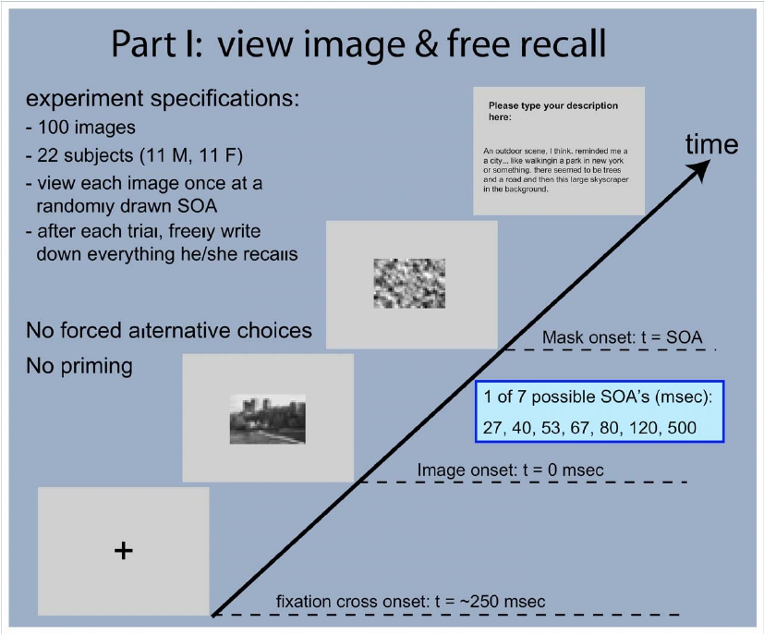

Slide 5
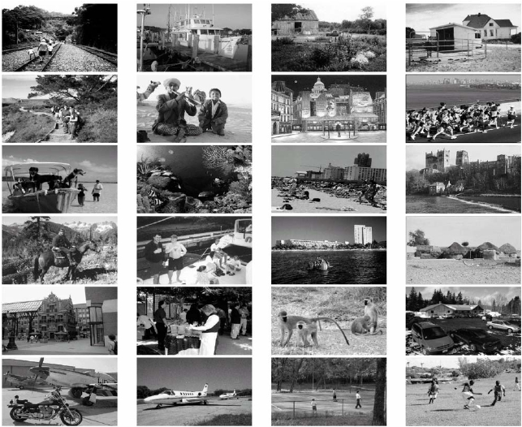
Stimuli: outdoor images

Slide 6
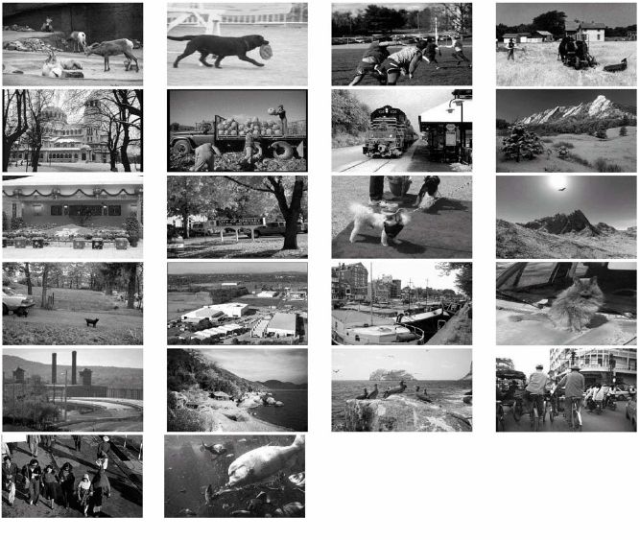
Stimuli: outdoor images

Slide 7
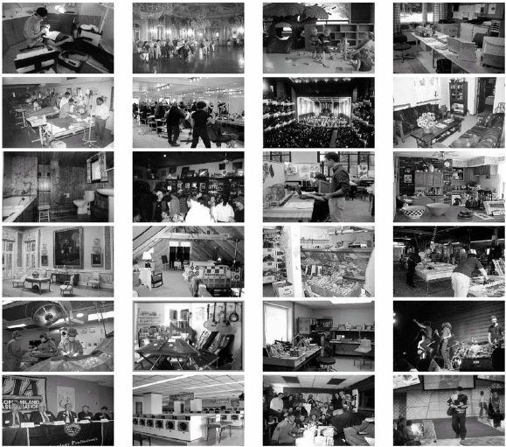
Stimuli: indoor images

Slide 8
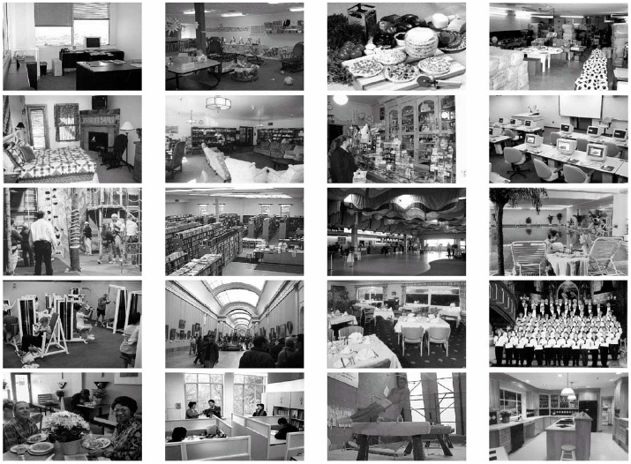
Stimuli: indoor images

Slide 9
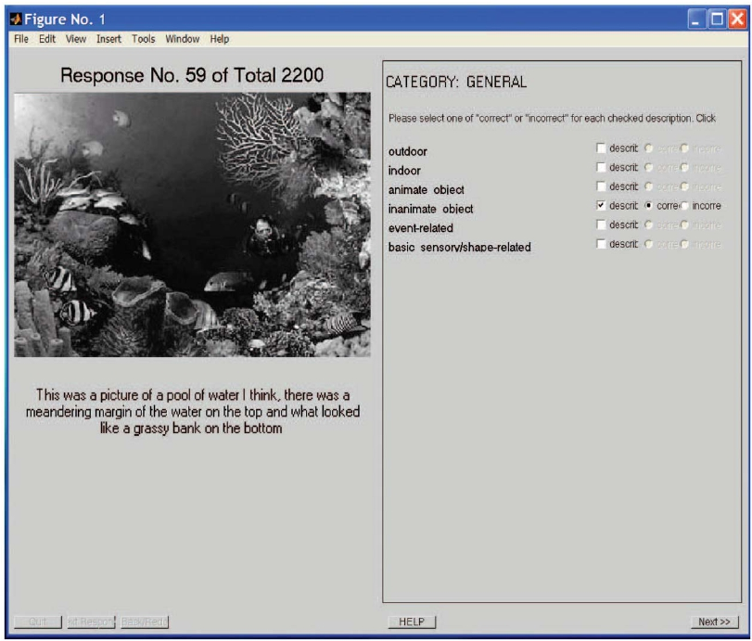

Slide 10
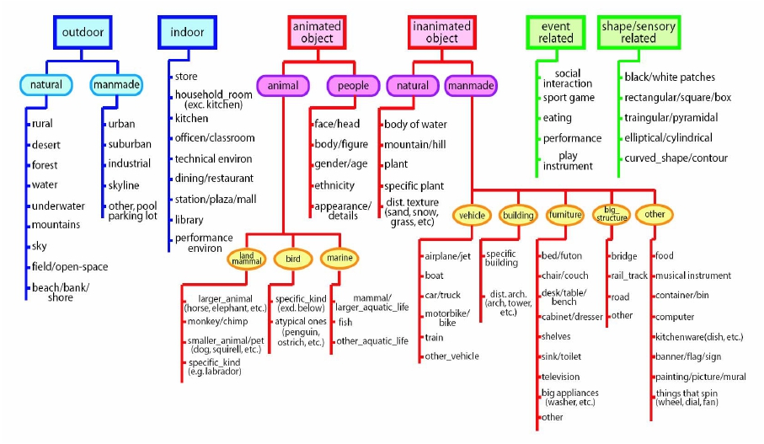

Slide 12
Experiment specifications
• 5 naïve scorers
• 105 attributes assessed for each
description
• 2 scoring fields for each attribute:
– whether the attribute is described
– if yes, whether it is accurate

Slide 13
Computation of score
Attribute: building, Image: 52, PT: 500ms
Subject
1
2
3
Correctly described?
Yes
No
Yes
Score: 0.67
For image 52, normalize by max score across all PT

Slide 14
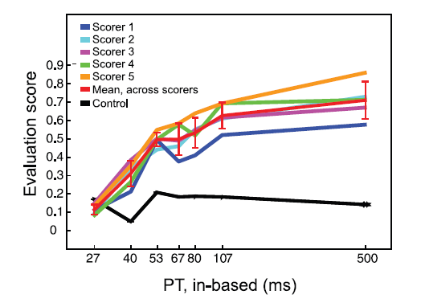
How the scorers perform
Building attribute

Slide 15
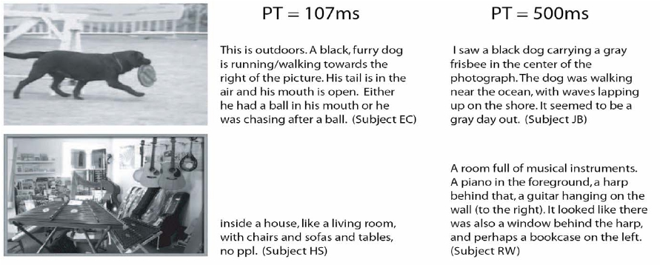

Slide 16
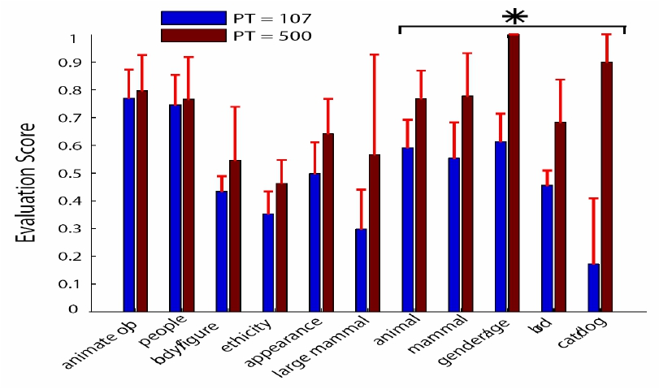
The “content” of a single fixation
Animate objects

Slide 17
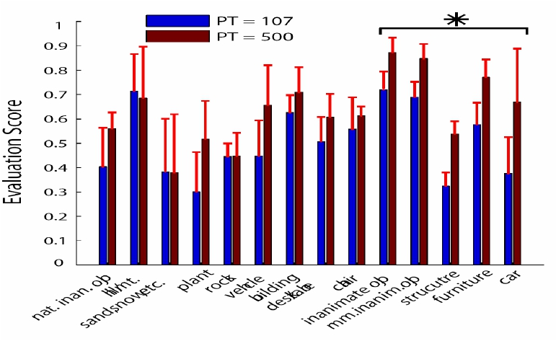
The “content” of a single fixation
Inanimate objects

Slide 18
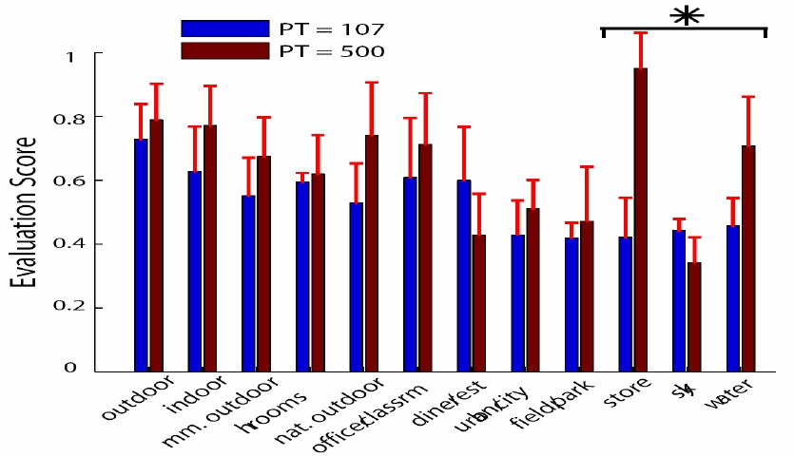
The “content” of a single fixation
Scene

Slide 19
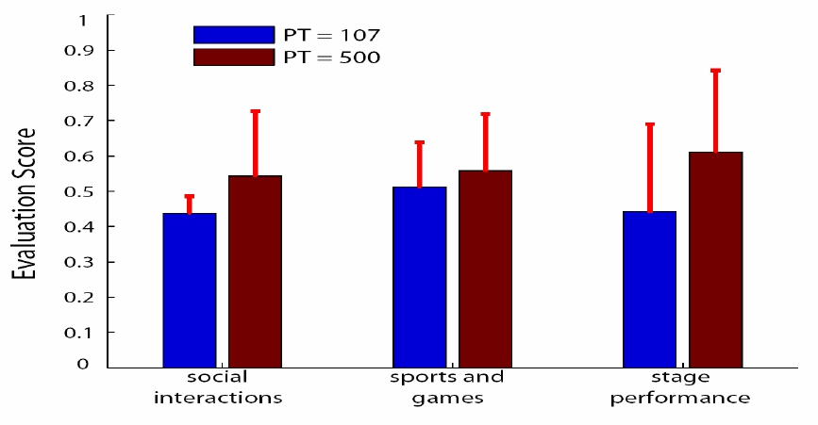
The “content” of a single fixation
Social events

Slide 20
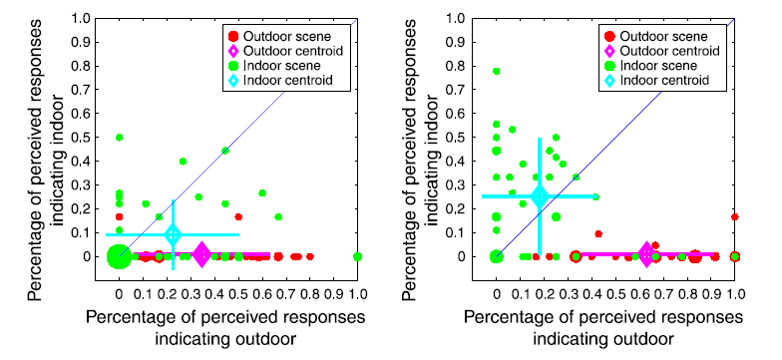
Outdoor vs. indoor bias

Slide 21
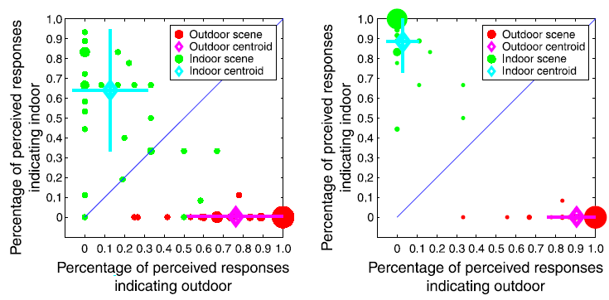
Outdoor vs. indoor bias

Slide 22
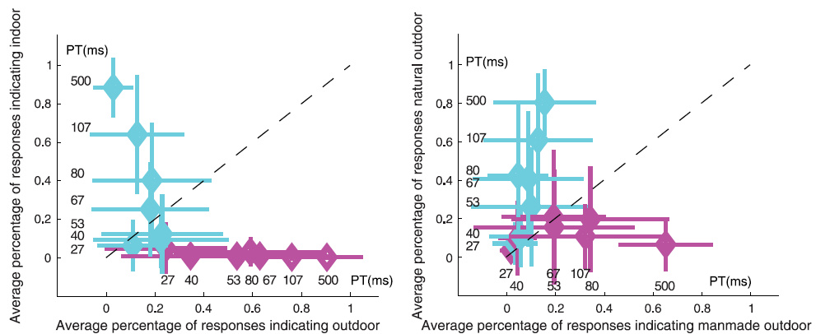
Summary plots

Slide 23
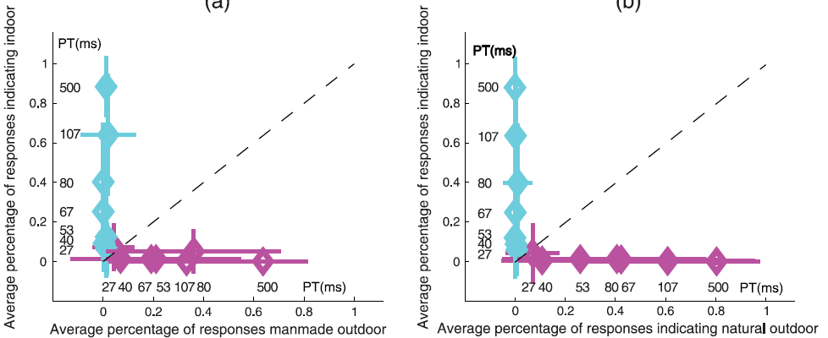
Summary plots

Slide 24
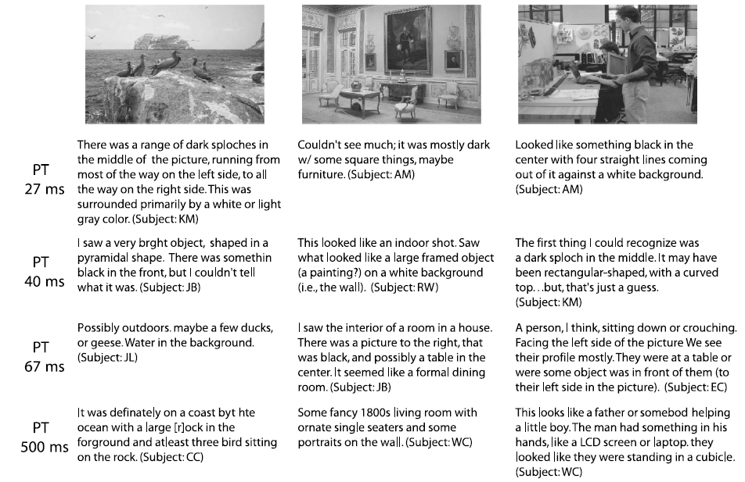
Notes:
When the PT is short (e.g., PT = 27 or 40 ms), shape- and low-level sensory-featurerelated (such as Bdark,[ Blight,[ and Brectangular[)
terminology predominates in the free-recall responses. As the display time increases, subjects more often identify objects as well as scene categories.

Slide 25
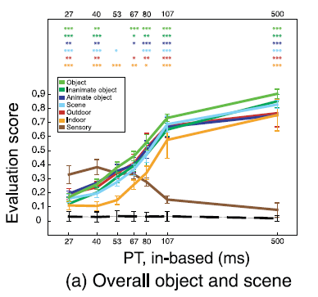
Sensory vs. object/scene
Notes:
compare the responses of low-level visual/sensory information to the high-level information related to object and scene superordinate categorizations

Slide 26
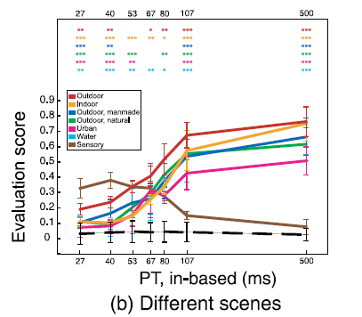
Sensory vs. object/scene
Notes:
allow us to inspect more closely scene and object perception at finer levels of detail

Slide 27
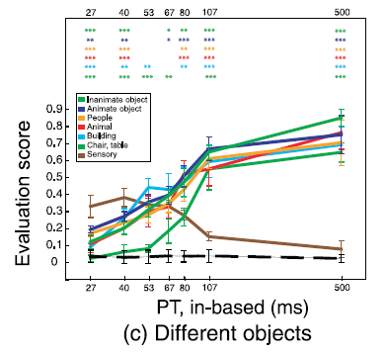
Sensory vs. object/scene

Slide 28
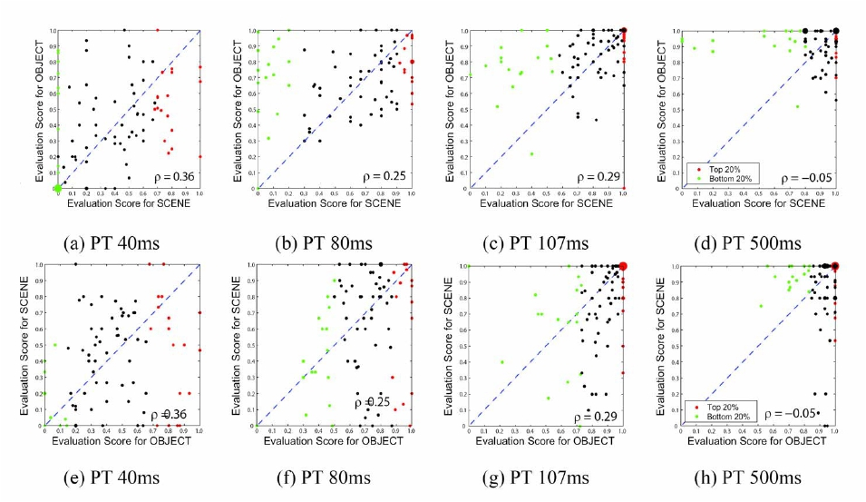
Correlation of object/scene
perception
Notes:
Object recognition performance versus scene recognition performance at various PTs
We show the relationship between object-level information and scene-level information
Each dot on the scatter plot represents one image. If more than one image falls on the same coordinate, the size of the dot increases linearly

Slide 29
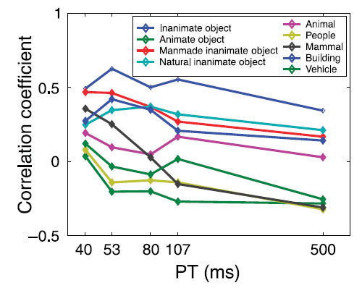
Scene vs. objects

Slide 30
Conclusions
• Outdoor scene bias
• Less information needed for
shape/sensory recognition
• Weak correlation between scene and
object perception

Slide 31
80 million tiny images: a large dataset for non-parametric object and scene recognition

Slide 32

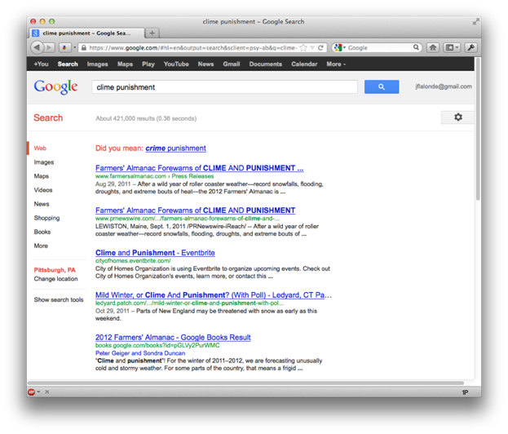
A.I. for the postmodern world:
  All questions have already been answered…many times, in many ways
  Google is dumb, the “intelligence” is in the data

Slide 33
How about visual data?
The key question here in this paper is: How big does the image dataset need to be to robustly perform recognition using simple nearest-neighbor schemes?
Complex classification methods don’t extend well
Can we use a simple classification method?

Slide 34
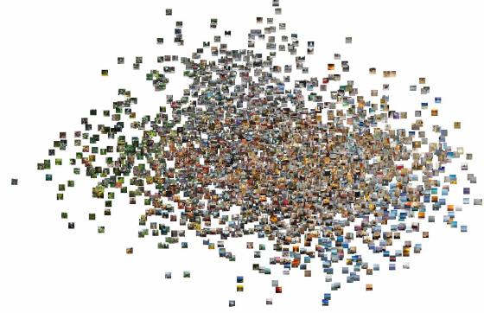
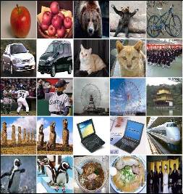
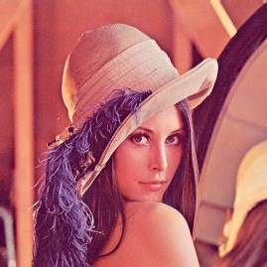
Past and future of image datasets in computer vision
Number
of
pictures
10²⁰
Human Click Limit
(all humanity taking
one picture/second
during 100 years)
COREL
10¹⁵
Lena
a dataset in one picture
10¹⁰
2 billion
10⁵
40.000
10⁰
1972
1996
2007
2020?
Time
Slide by Antonio Torralba
Notes:
The human click limit is the number of all the pictures that the 6 billion humans can take in 100 years (which an overestimate of the time for which digital photography exists). Adding a few more numbers will not change much because it is in log scale.
6000000000*1*60*60*24*365*100 = 10^19
I think it is fun to show the limit. So the graphs have to saturate, eventually… There can not be more pictures than what people can take.

Slide 35
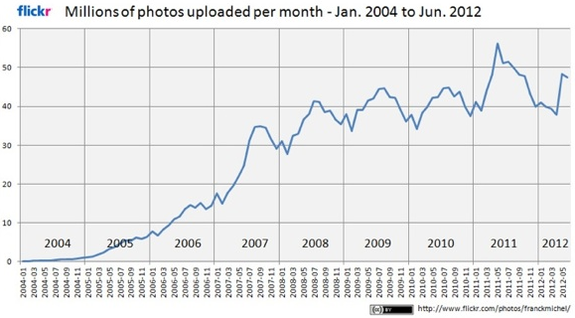
How big is Flickr?
100M photos updated daily
6B photos as of August 2011!
  ~3B public photos
Credit: Franck_Michel (http://www.flickr.com/photos/franckmichel/)

Slide 36
How Annotated is Flickr? (tag search)
Party – 23,416,126
Paris – 11,163,625
Pittsburgh – 1,152,829
Chair – 1,893,203
Violin – 233,661
Trashcan – 31,200

Slide 37

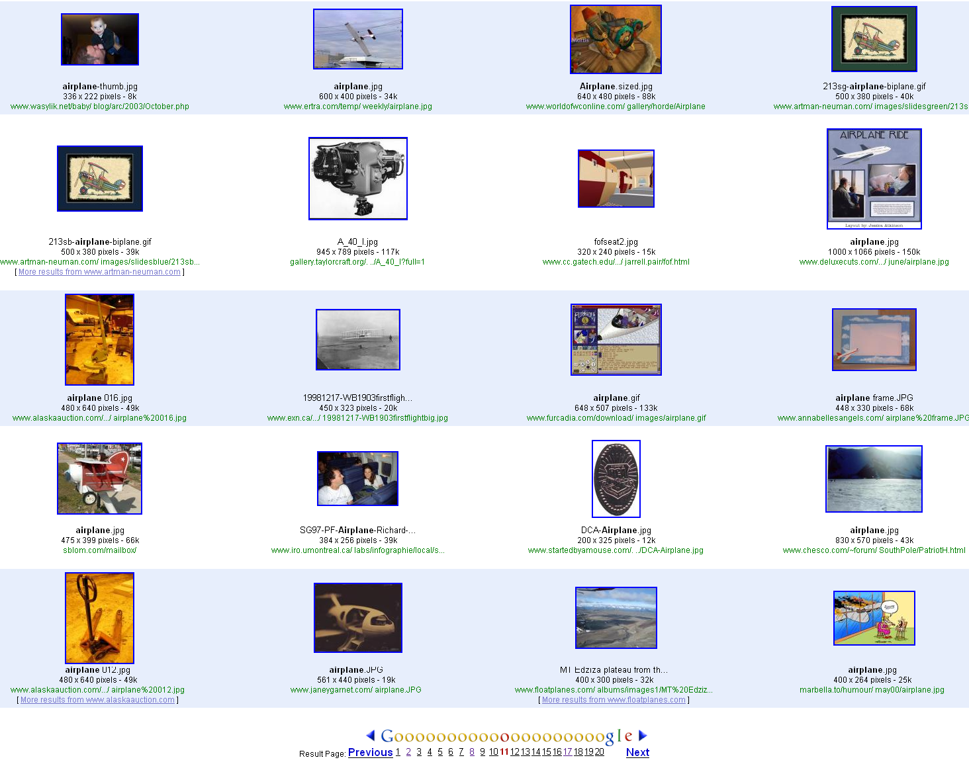
Noisy Output from Image Search Engines
Notes:
the images gathered by the engines are loosely labeled in that the visual content is often unrelated to the query word
cleaning up the data by removing images visually unrelated to the query word
However, due to the extreme size of our dataset, it is not practical to employ these methods. we show that reasonable recognition performances can be achieved despite the high labeling noise.

Slide 38
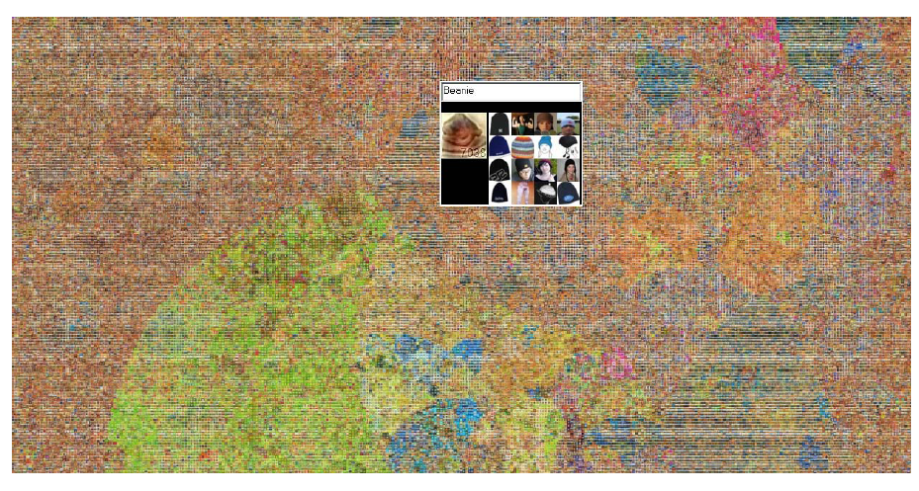
Thumbnail Collection Project
Collected 80M images
http://people.csail.mit.edu/torralba/tinyimages

Slide 39
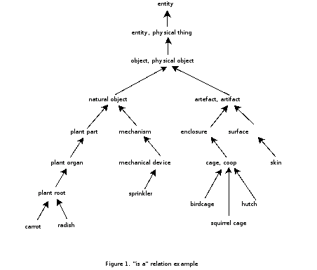
Thumbnail Collection Project
Collect images for ALL objects
  List obtained from WordNet
  75,378 non-abstract nouns in English

Slide 40







Web image dataset
79.3 million images
Collected using image
search engines
List of nouns taken from
Wordnet
Save all images in 32x32
resolution
Notes:
We do this by extracting all non-abstract nouns from the database, 75,062 of them in total
We selected 7 independent image search engines: Altavista, Ask, Flickr, Cydral, Google, Picsearch andWebshots (others have outputs correlated with these). We automatically download all the images provided by each engine for all 75,846 non-abstract nouns. Running over 8 months, this method gathered 97,245,098 images in total.
The dataset fits onto a single hard disk, occupying 760Gb in total

Slide 41
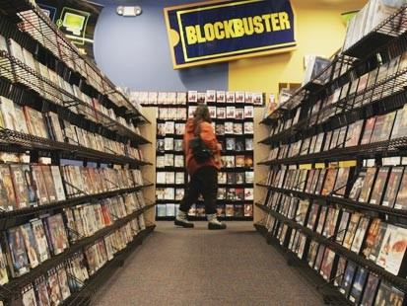
How Much is 80M Images?
One feature-length movie:
  105 min = 151K frames @ 24 FPS
For 80M images, watch 530 movies
How do we store this?
  1k * 80M = 80 GB
  Actual storage: 760GB

Slide 42



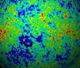

Powers of 10
Number of images on my hard drive: 10⁴
Number of images seen during my first 10 years: 10⁸
(3 images/second * 60 * 60 * 16 * 365 * 10 = 630720000)
Number of images seen by all humanity: 10²⁰
106,456,367,669 humans¹ * 60 years * 3 images/second * 60 * 60 * 16 * 365 =
1 from http://www.prb.org/Articles/2002/HowManyPeopleHaveEverLivedonEarth.aspx
Number of photons in the universe: 10⁸⁸
Number of all 8-bits 32x32 images: 10⁷³⁷³
256 ^{32*32*3} ~ 10⁷³⁷³
Notes:
so don’t listen to anyone claiming to brute force image space!
But most of image space is empty, never observed.

Slide 43
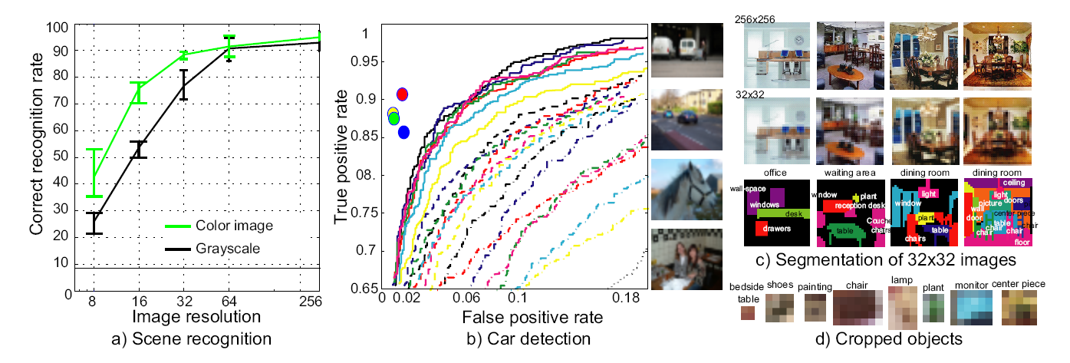
Are 32x32 images enough?
Notes:
the entire image is just a vector of 3072 dimensions with 8 bits per dimension
a) Human performance on scene recognition as a function of resolution. The green and black curves show the performance on color and gray-scale images respectively. For color 32 × 32 images the performance only drops by 7% relative to full resolution, despite having 1/64th of the pixels. b) Car detection task on the PASCAL 2006 test dataset. The colored dots show the performance of four human subjects classifying tiny versions of the test data. The ROC curves of the best vision algorithms (running on full resolution images) are shown for comparison. All lie below the performance of humans on the tiny images, which rely on none of the high-resolution cues exploited by the computer vision algorithms. c) Humans can correctly recognize and segment objects at very low resolutions, even when the objects in isolation can not be recognized (d)

Slide 44
Are 32x32 images enough?
Notes:
the entire image is just a vector of 3072 dimensions with 8 bits per dimension
a) Human performance on scene recognition as a function of resolution. The green and black curves show the performance on color and gray-scale images respectively. For color 32 × 32 images the performance only drops by 7% relative to full resolution, despite having 1/64th of the pixels. b) Car detection task on the PASCAL 2006 test dataset. The colored dots show the performance of four human subjects classifying tiny versions of the test data. The ROC curves of the best vision algorithms (running on full resolution images) are shown for comparison. All lie below the performance of humans on the tiny images, which rely on none of the high-resolution cues exploited by the computer vision algorithms. c) Humans can correctly recognize and segment objects at very low resolutions, even when the objects in isolation can not be recognized (d)

Slide 45
Are 32x32 images enough?
Notes:
the entire image is just a vector of 3072 dimensions with 8 bits per dimension
a) Human performance on scene recognition as a function of resolution. The green and black curves show the performance on color and gray-scale images respectively. For color 32 × 32 images the performance only drops by 7% relative to full resolution, despite having 1/64th of the pixels. b) Car detection task on the PASCAL 2006 test dataset. The colored dots show the performance of four human subjects classifying tiny versions of the test data. The ROC curves of the best vision algorithms (running on full resolution images) are shown for comparison. All lie below the performance of humans on the tiny images, which rely on none of the high-resolution cues exploited by the computer vision algorithms. c) Humans can correctly recognize and segment objects at very low resolutions, even when the objects in isolation can not be recognized (d)

Slide 46
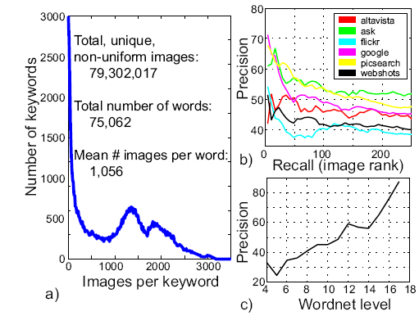
Statistics of database of tiny images
Notes:
a) A histogram of images per keyword collected. Around 10% of keywords have very few images. b) Performance of the search various engines (evaluated on hand-labeled ground truth). c) Accuracy of the labels attached at each image as a function of the depth in the Wordnet tree
Despite 32×32 being very low resolution, each image lives in a space of 3072 dimensions. This is a very large space — if each dimension has 8 bits, there are a total of 10^7400 possible images. This is a huge number, especially if we consider that a human in a 100 years only gets to see 10^11 frames (at 30 frames/second).

Slide 47
Lots
Of
Images
A. Torralba, R. Fergus, W.T.Freeman. PAMI 2008

Slide 48
Lots
Of
Images
A. Torralba, R. Fergus, W.T.Freeman. PAMI 2008

Slide 49
Lots
Of
Images

Slide 50
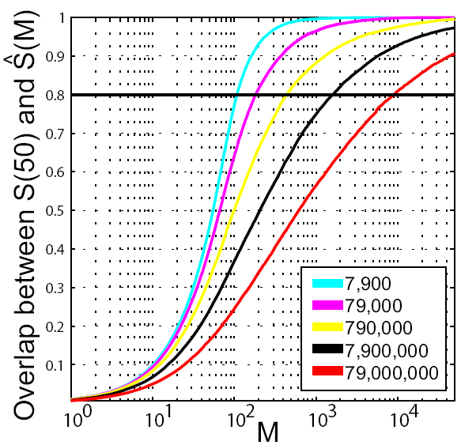
First Attempt
Used SSD++ to find nearest neighbors of query image
  Used first 19 principal components
Notes:
Computing similarities among 7.9 × 107 images is computationally expensive. To improve speed, we index the images using
the first 19 principal components of the 7.9 × 107 images
We define SN as the set of N exact nearest neighbors and SM as the set of M approximate nearest neighbors.

Slide 51
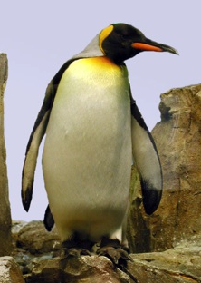
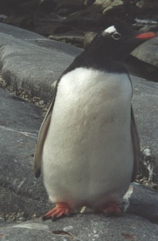

SSD says these are not similar
?

Slide 52
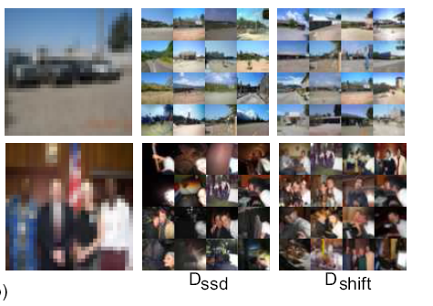
Another similarity measure

Slide 53
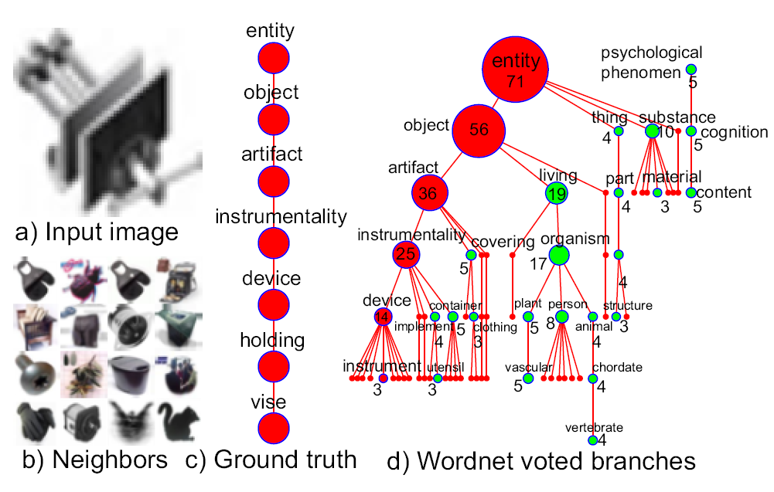
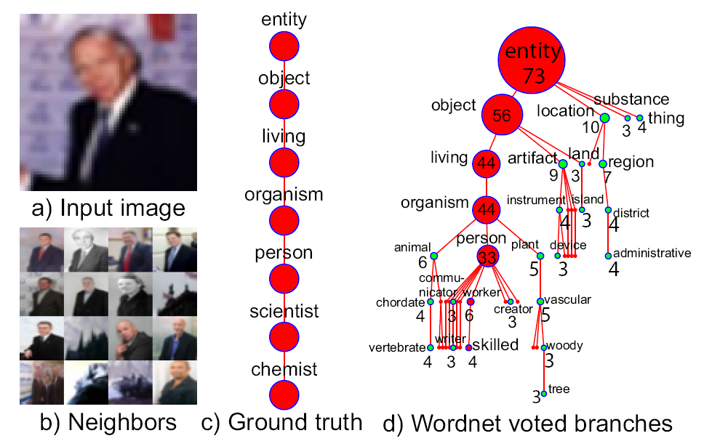
Wordnet Voting Scheme
Ground truth
One image – one vote
Notes:
Why 73 votes
Given a query image, the neighbors are found using some similarity measure (typically Dshift) . Each neighbor in turn votes for its branch within the Wordnet tree. Votes from the entire sibling set are accumulated across a range of semantic levels

Slide 54
Classification at Multiple Semantic Levels
Votes:
Living 44
Artifact 9
Land 3
Region 7
Others 10
Votes:
Animal 6
Person 33
Plant 5
Device 3
Administrative 4
Others 22
Notes:
Classification may be performed by assigning the query image the label with the most votes at the desired height (i.e. semantic level) within the tree, the number of votes acting as a measure of confidence in the decision.

Slide 55
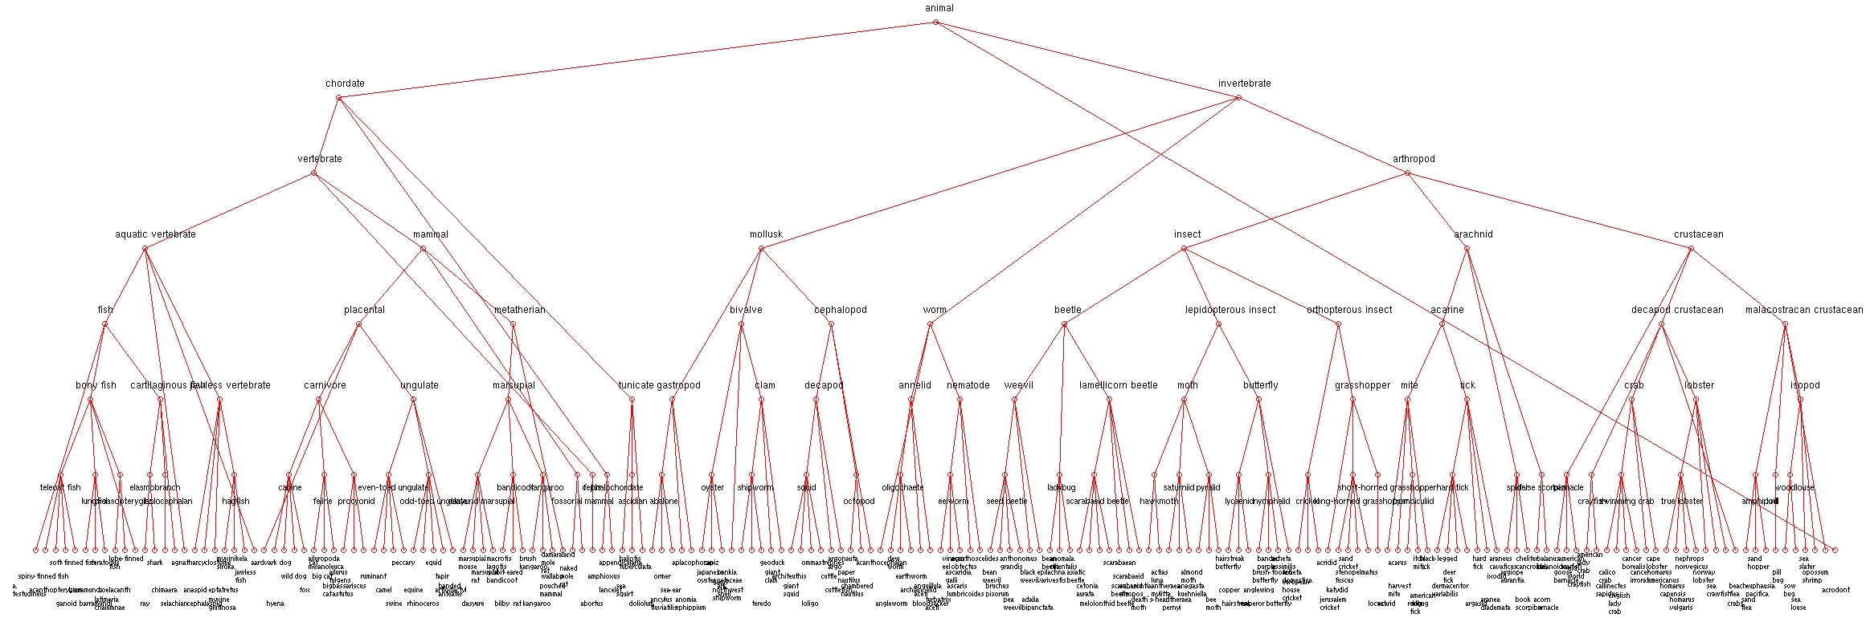

Slide 56
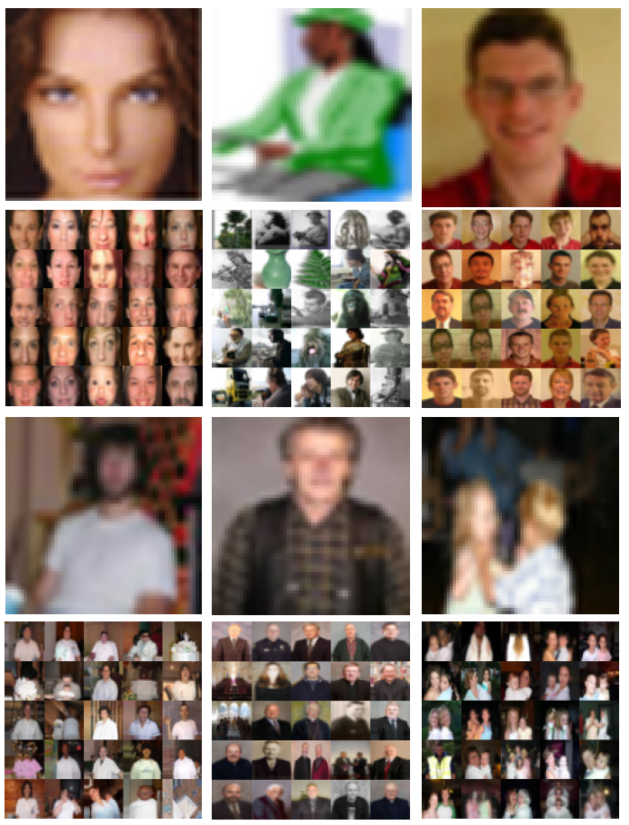
Person Recognition
23% of all images
in dataset contain
people
Wide range of
poses: not just
frontal faces

Slide 57
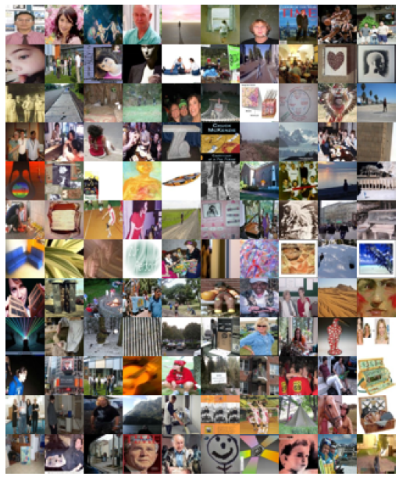
Person Recognition – Test Set
1016 images from
Altavista using
“person” query
High res and 32x32
available
Disjoint from 79
million tiny images

Slide 58
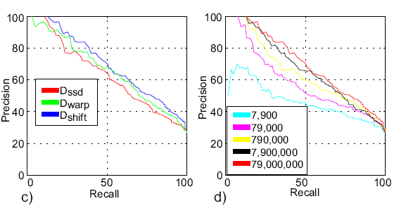

Slide 59
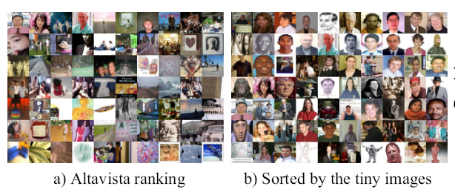

Slide 60
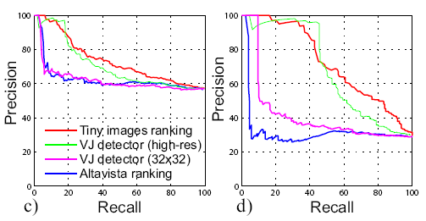
Person Recognition
Task: person in image or not?
(c) shows the recall-precision curves for all 1018 images gathered from
Altavista, and
(d) shows curves for the subset of 173 images where people occupy at least 20% of the image

Slide 61
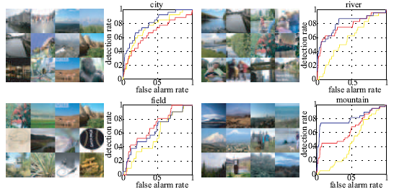
Scene classification
yellow = 7,900 image training set; red = 790,000 images; blue = 79,000,000 images
Notes:
Scene classification using the randomly drawn 1125 image test set. Note that the classification is “mountain” vs all classes present in the test set
(which includes many kinds of objects), not “mountain” vs “field”, “city”, “river” only. Each quadrant shows some examples of high scoring images
for that particular scene category, along with an ROC curve (yellow = 7,900 image training set; red = 790,000 images; blue = 79,000,000 images).

Slide 62


Slide 63
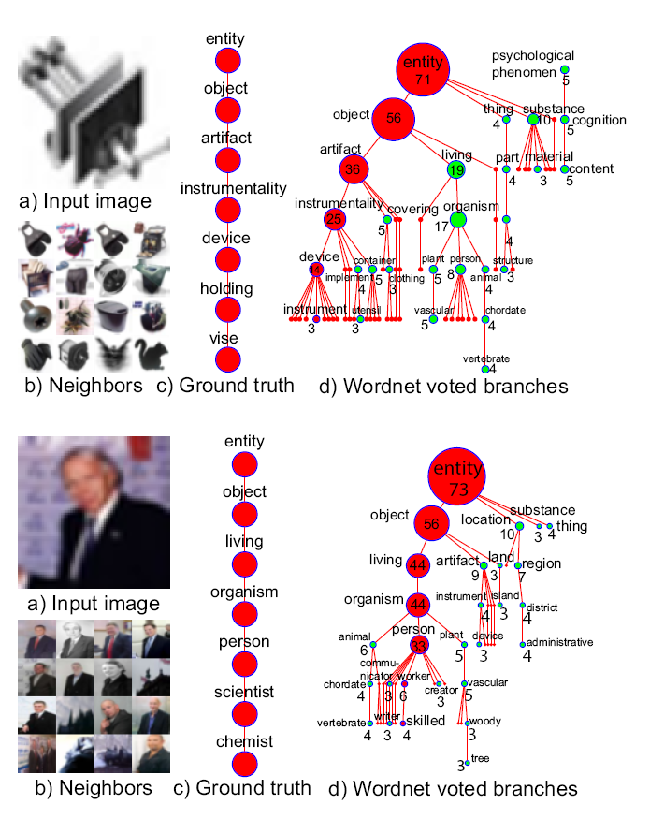
What If we have
Labels…
Notes:
We now attempt to use our dataset for object and scene recognition. use a simple nearest-neighbor scheme
An additional factor in our dataset is the labeling noise. To cope with this we propose a voting scheme based around the Wordnet semantic hierarchy
If classification is performed at some intermediate semantic level, for example using the noun “person”, we need not only consider images gathered from the Internet using “person”. Using the Wordnet hierarchy tree, we can also draw on all images belonging to nouns whose hypernyms include “person” (for example, “arithmetician”).

