Slide 1
Language and images
Abhijit Sarkar

Slide 2
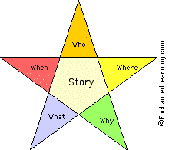
Adjective
Noun
Verbs
Adverbs

Slide 3
Sentence source - UIUC Sentence dataset
Comparison using Gist : 4X4 window
Test picture source – VOC2012
No object detectors

Slide 4
Using only same category

Slide 8
Rank 2
Low
Plane
Day
gray
River
Water
Red
Banking
maneuvers

Slide 9
When testing with other category

Slide 10
Rank 1

Slide 11
Rank 2

Slide 12
Rank 2

Slide 13
Test with any picture
Take top 10 ranked results (10 out of 1000)
Try to identify the best

Slide 21
Not so Good results

Slide 23
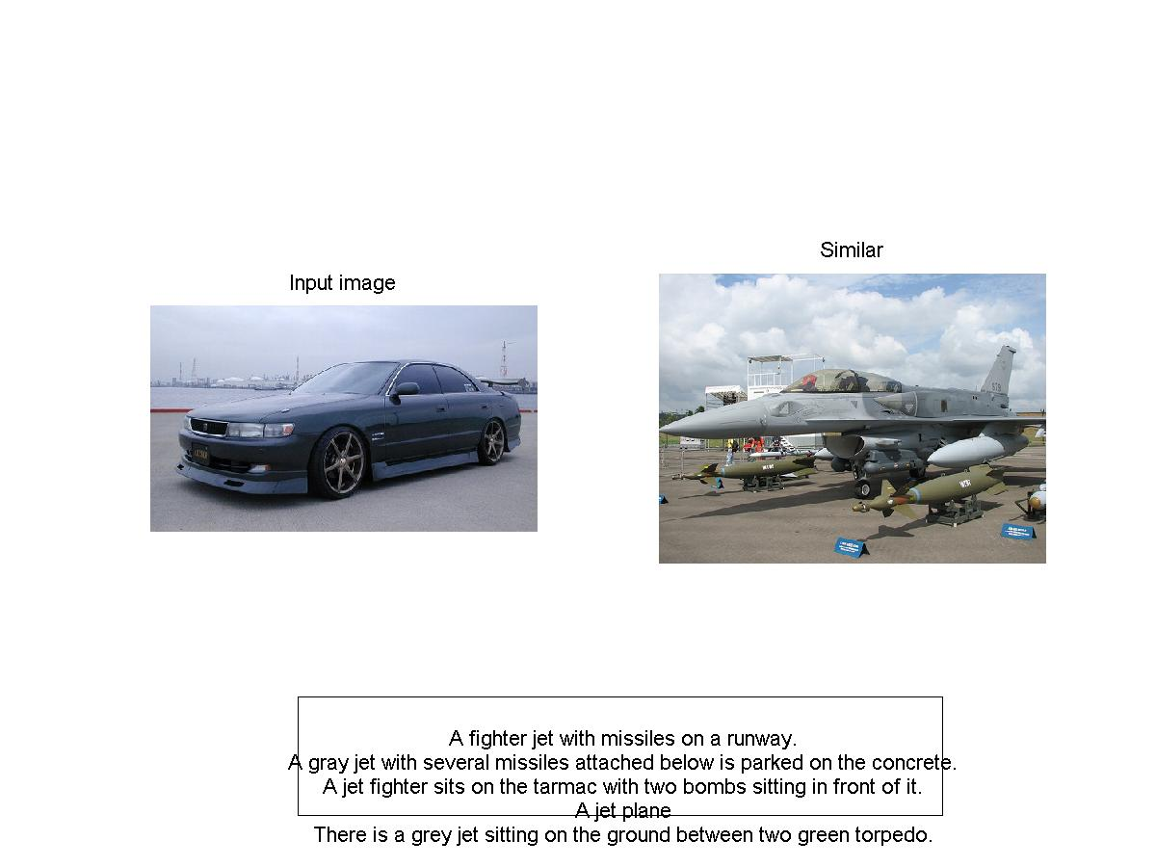

Slide 24
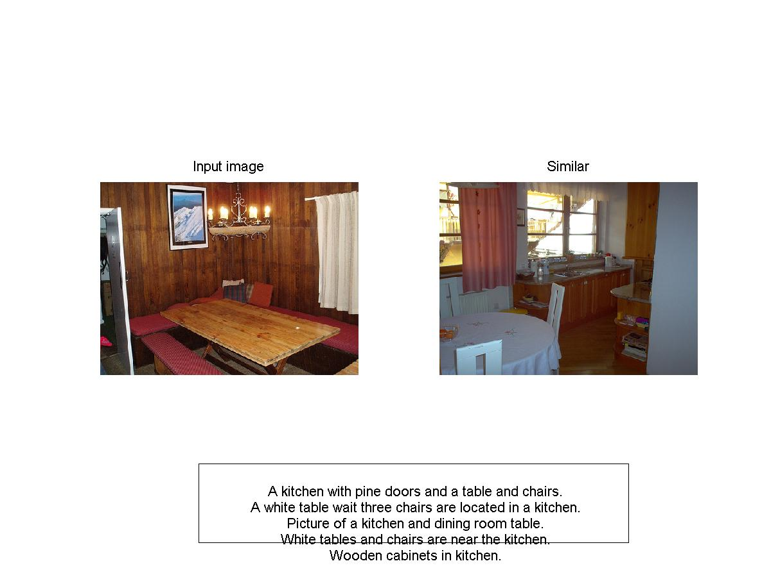

Slide 25
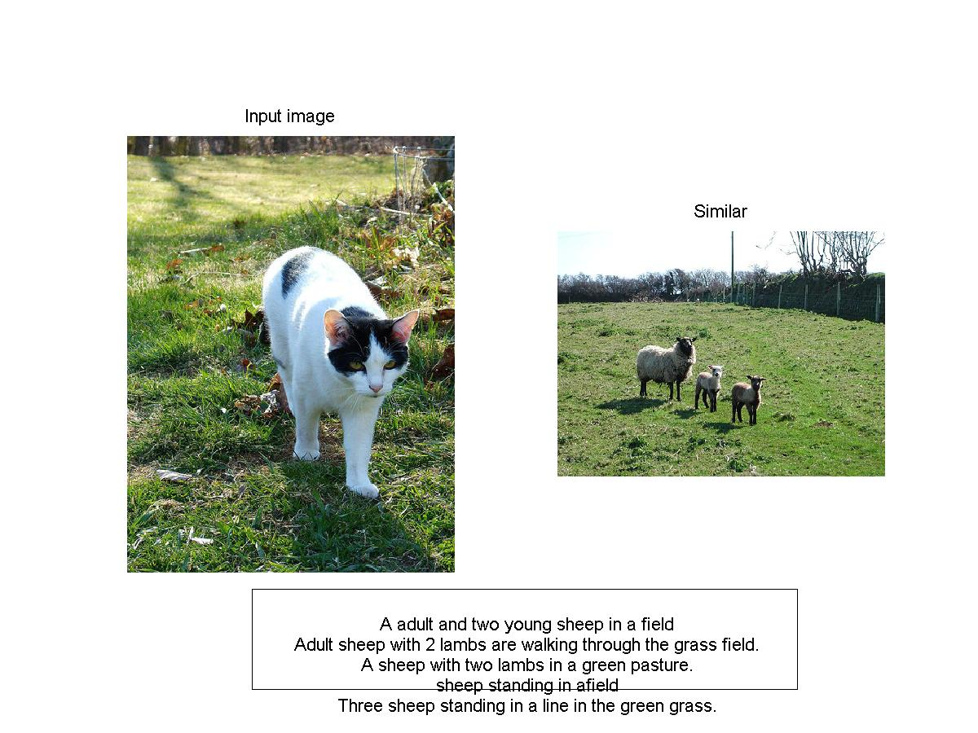

Slide 27
And some Really Bad …….

Slide 29
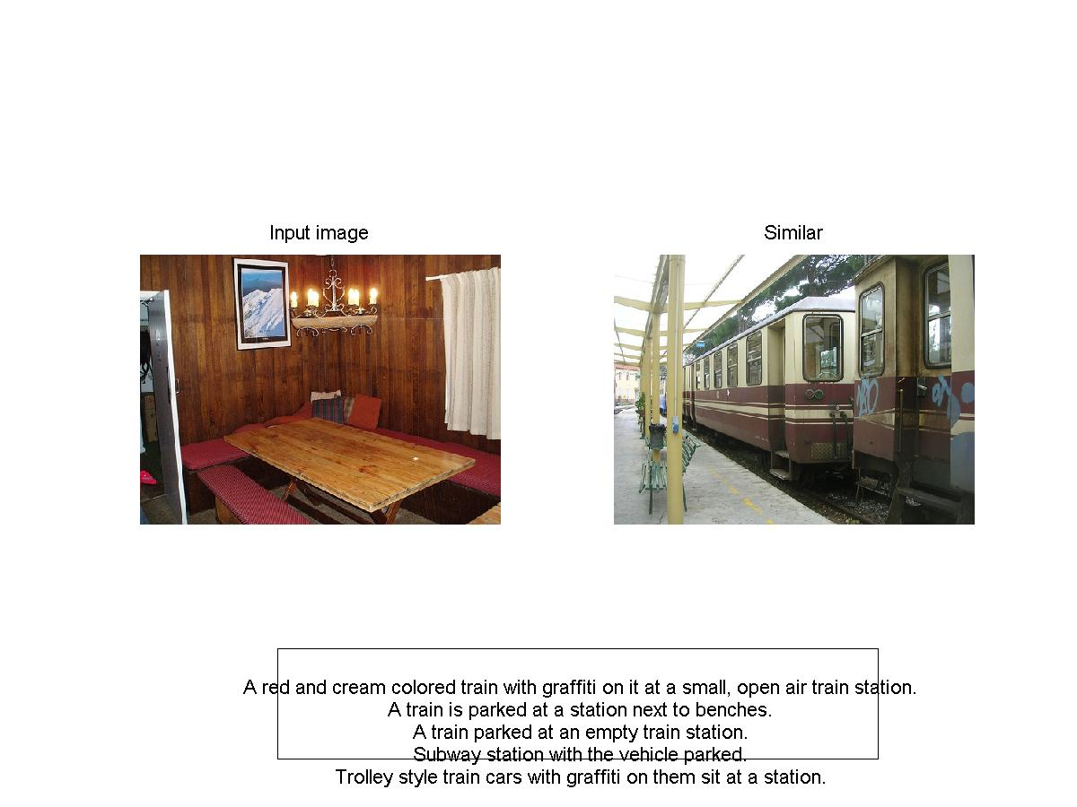

Slide 31
Conclusion
Good Results - – includes sky or similar ambience
Airplane
Horse
Bike
Indoor scene
Sofa
Bad Results
Cat
Dog
Birds

Slide 32
Gender

Slide 33
Gender
Age
Nationality

Slide 34
Direction
Left/ Right
Front/ Side

Slide 35
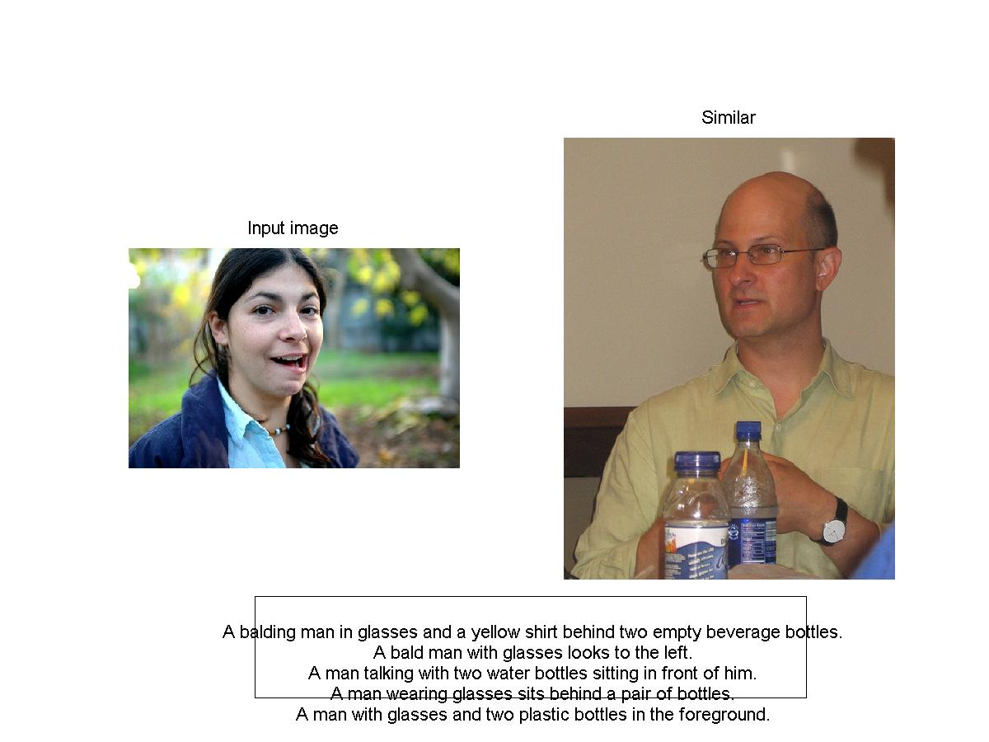
Details
Direction

Slide 36
Minute Details

Slide 37
Conclusion
“Sentences are richer than lists of words, because they describe activities, properties of objects”
We use words like “peaceful”, “Calm”, “Turbulent”, “sweet”, “lone”

Slide 38
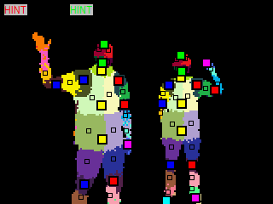
Thanks
Acknowlegements
Dr. Devi Parikh
image Credit : Jamie Shotton

