Slide 1
What is an Object? —— an experimental evaluation
Presented by: Yao Pan

Slide 2
Overview
Experiment Setup
Window Score Visualization
Window Score Threshold
Pascal Criterion Sensitivity

Slide 3
Environment Setup
http://groups.inf.ed.ac.uk/calvin/objectness/

Slide 4
Environment Setup
Tips： 1. Run on a Linux system. Windows does not work.
2. Recompile the mex file in case the function is not recognized.
Ubuntu12.04LTS
Matlab2012b for Unix
G++ 4.6.3

Slide 5
The experiment the authors have done
DR(Detection Rate): percentage of ground-true objects covered by at least one window

Slide 6
Window Number
DR(Detection Rate): percentage of ground-true objects covered by at least one window

Slide 7
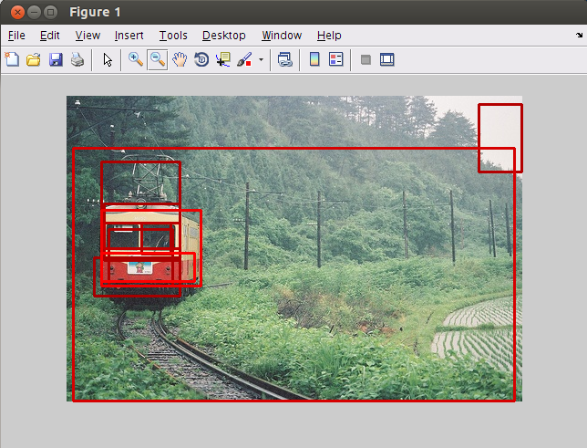
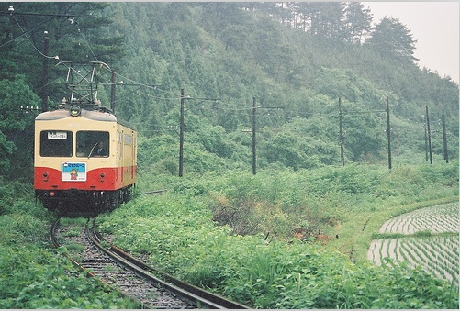
Output
Input
Choose the number of boxes

Slide 8
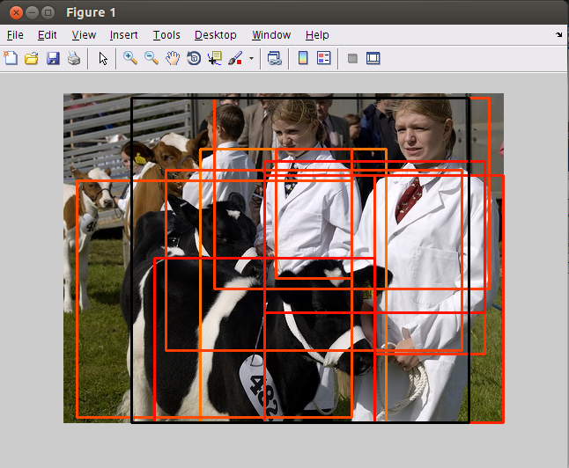

Slide 9
Problem is:
How can I know how many boxes does it need?

Slide 10
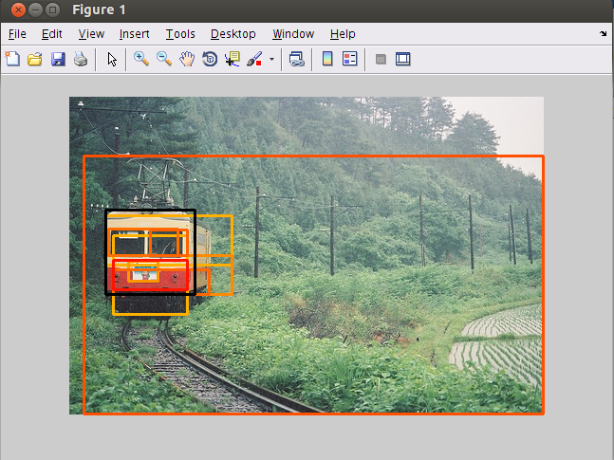
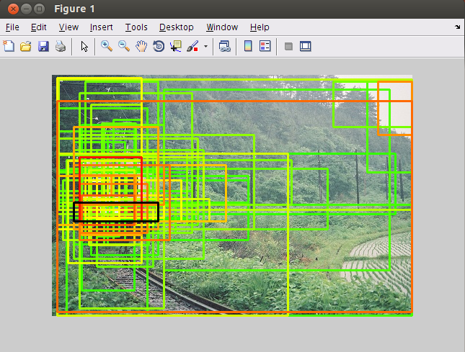
Sample 100 windows
Sample 10 windows
Score Range: 0 to 1
High Score
Low Score

Slide 11
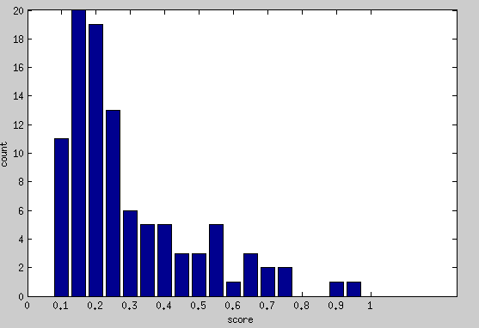
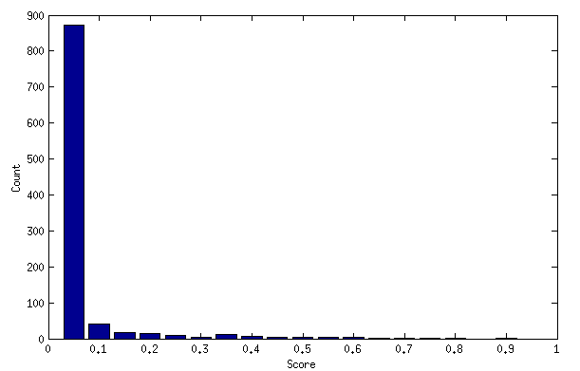
Choose a score threshold
Sample 100 windows
Sample 1000 windows
Choose 20 test images, sample 1000 windows for each.
Score Threshold | Detect the object and score is above threshold | Above Threshold and really cover the object
0.8 | 26.7% | 4%
0.7 | 39.1% | 3%
0.6 | 50% | 2.3%
0.5 | 76.3% | 1.7%
Notes:
Sun dataset object

Slide 12
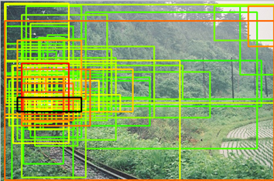
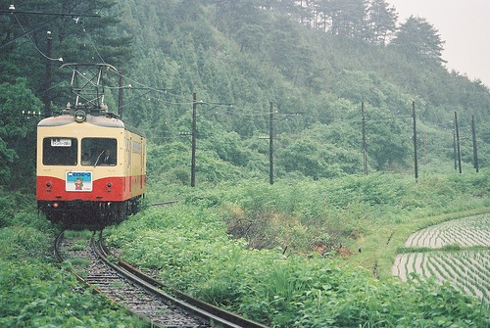
What does it imply:
Task1
Task2
Image: 500*300 pixel
Select a window manually and let the system tell you the possibility it contains an object.
Use: 32*32 pixel sliding window
(500-32)*(300-32)≈125000
Achieve more than 80% DR with only 1000 windows
Notes:
Sun dataset object

Slide 13
Conclusion
The algorithm is perfect for task1. Select much less windows but covers all the objects with high possibility.
The algorithm is not suited for task2. The score it generate is not very reliable. Even the score of the window is high, it is still very possible that it does not cover an object.
Notes:
Sun dataset object

Slide 14
PASCAL Criterion
Consider a window w to cover an object o if
1
2
1

Slide 15
Detection Rate vs Pascal Criterion
Number of Window | 10 | 50 | 100 | 500 | 1000
Pascal Criterion
0.4 | 34.5% | 56.4% | 69.1% | 83.6% | 89.1%
0.5 | 30.9% | 49.1% | 58.2% | 80% | 81.8%
0.6 | 23.6% | 43.6% | 50.9% | 65.5% | 67.3%
0.7 | 16.4% | 21.8% | 29.1% | 25.5% | 36.4%

Slide 16
Window Number

Slide 17
Other meaningful experiment:
Sensitivity to training data
The training dataset in the paper:
50 images randomly sampled from INRIA, Pascal VOC06, Caltech101.
How the choice of image and number of training image affect the final result?
Notes:
Sun dataset object

