Slide 1
Crowdsourcing
04/11/2013
Neelima Chavali
ECE 6504

Slide 2
Roadmap
Introduction
Adaptively learning the Crowd Kernel
The ESP Game
CrowdClustering
Experiment

Slide 3
Introducion
“The practice of obtaining needed services, ideas, or content by soliciting contributions from a large group of people, especially an online community”-Wikipedia
Combines the efforts of crowds of volunteers or part-time workers to give a significant result

Slide 4
Applications
Testing & Refining a Product(Netflix)
Market Research(Threadless)
Knowledge Management(wikipedia)
Customer Service(My Starbucks Ideas)
R&D
  Computer Vision/Machine Learning
  And many more fields

Slide 5
Adaptively Learning the Crowd Kernel
Paper:1

Slide 6
ML on New domain
Describe the dataset as a d-dimensional representation of every object in the domain.
Requires expertise
Two representations:
  Feature vector representation
  Kernel representation

Slide 7

1. Input
Database of $n$ objects, say images.

Slide 8
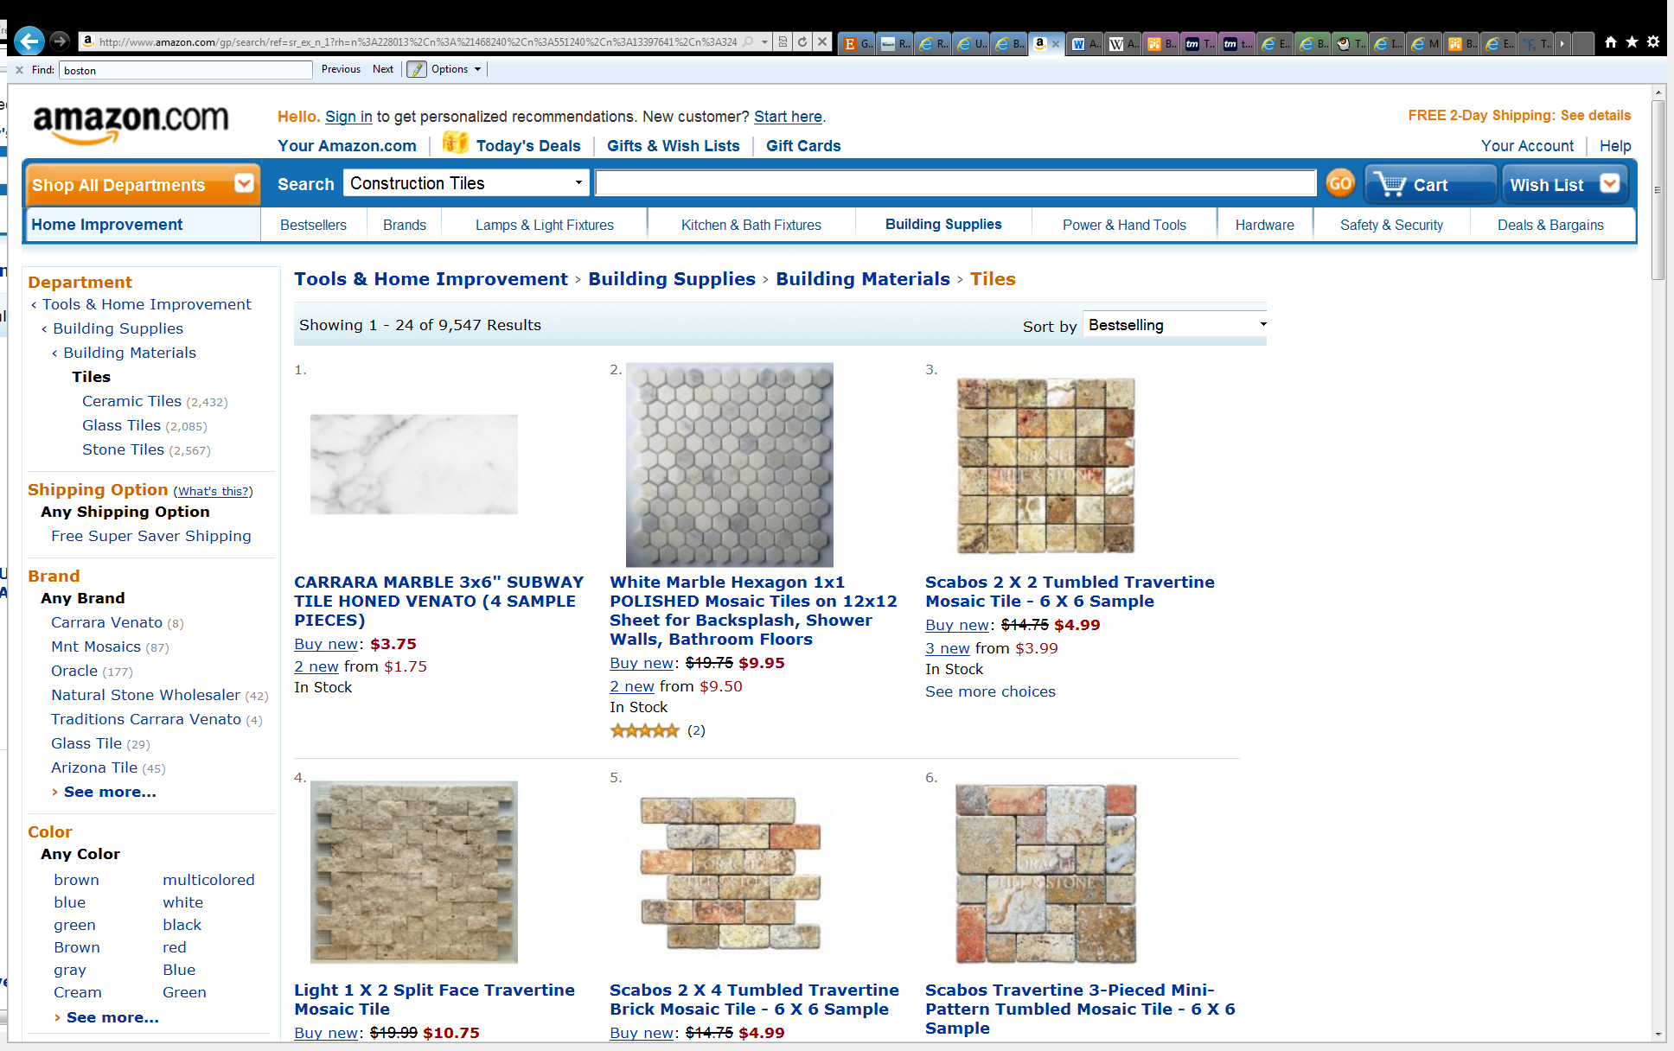
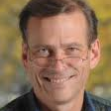
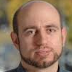
1. INPUT
+

Slide 9
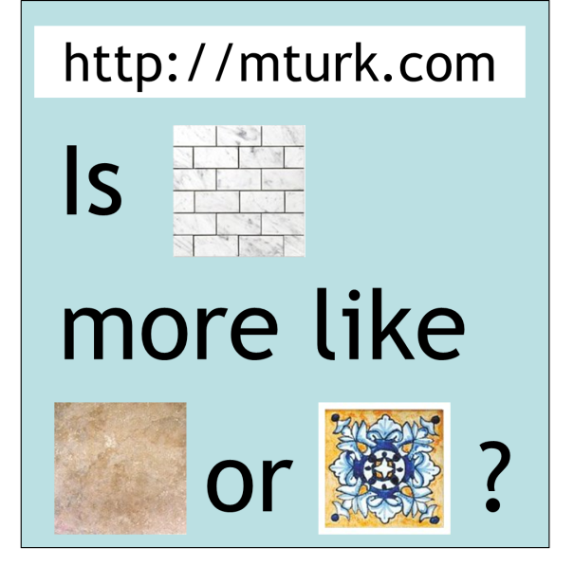
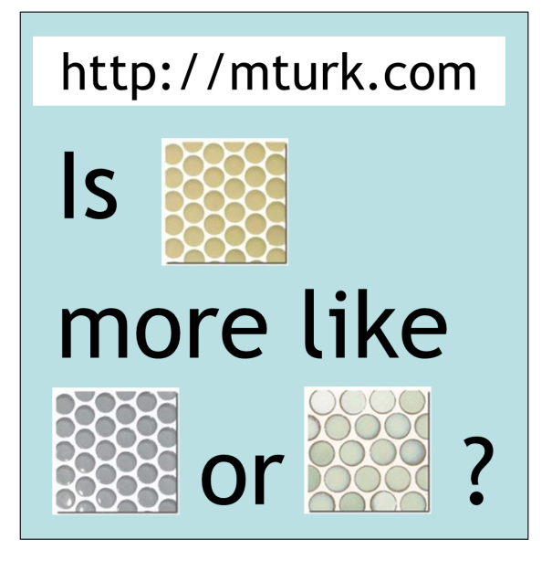
2. Crowd Queries
Notes:
http://65.215.1.20/faces/simp_sim4.py?instructions=112462&tid=shortCut112465&assignmentId=ASSIGNMENT_ID_NOT_AVAILABLE&hitId=218W618N46UXOGYOUO3EYNDS5YBOQA

Slide 10
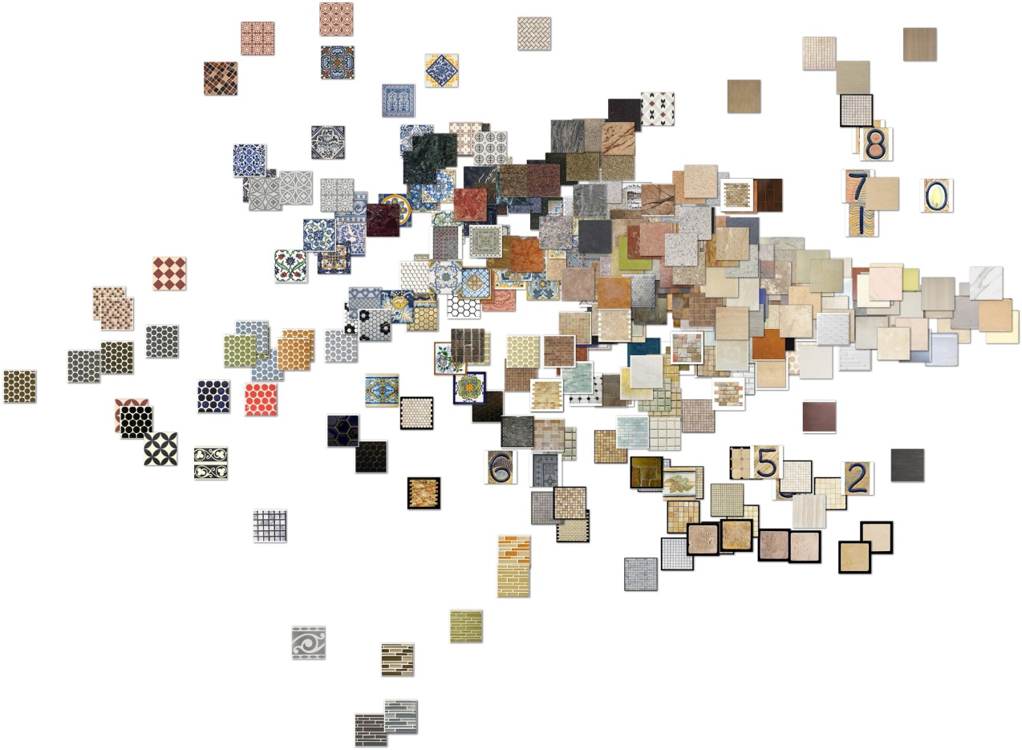
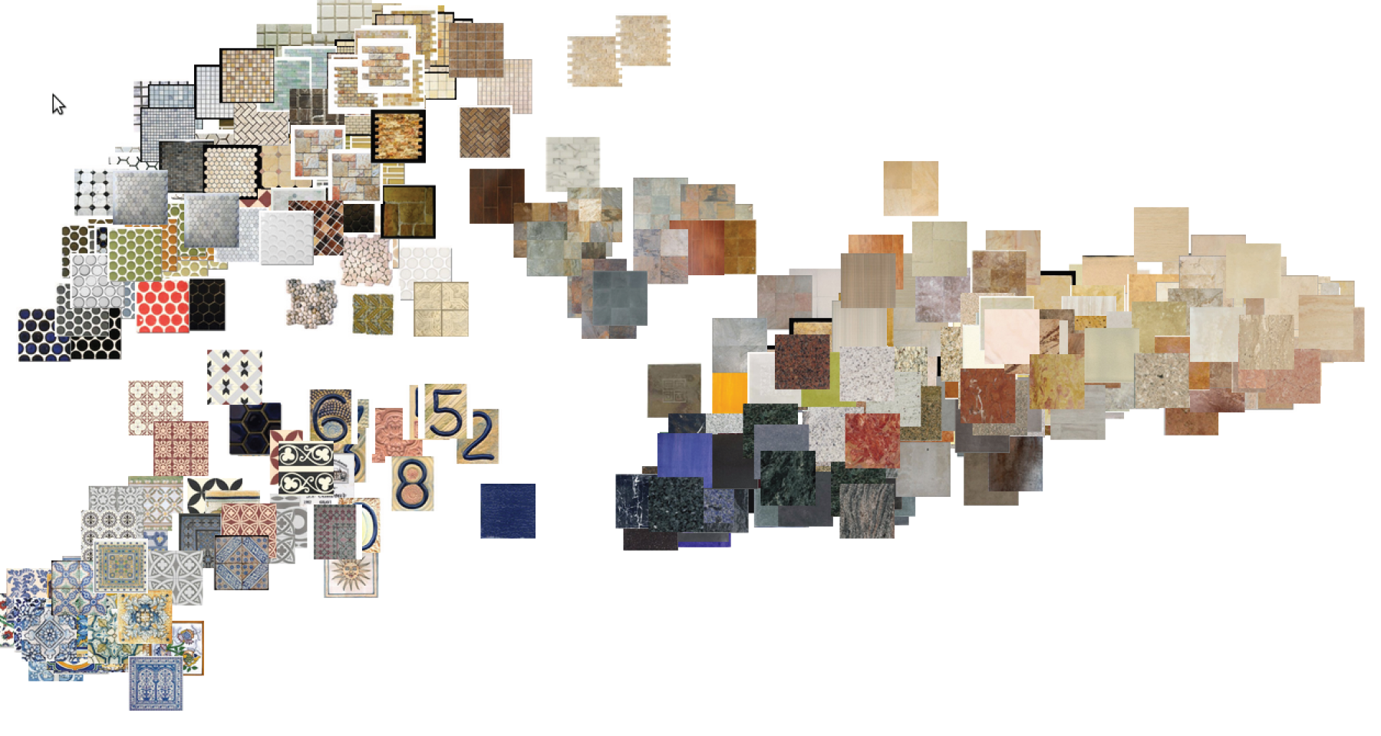


3. Output
embedding in $ℝ^{d}$

Slide 11
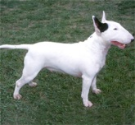
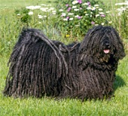
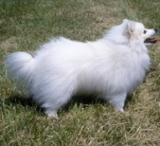
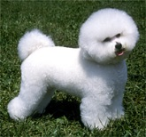




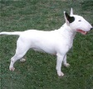




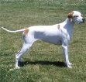





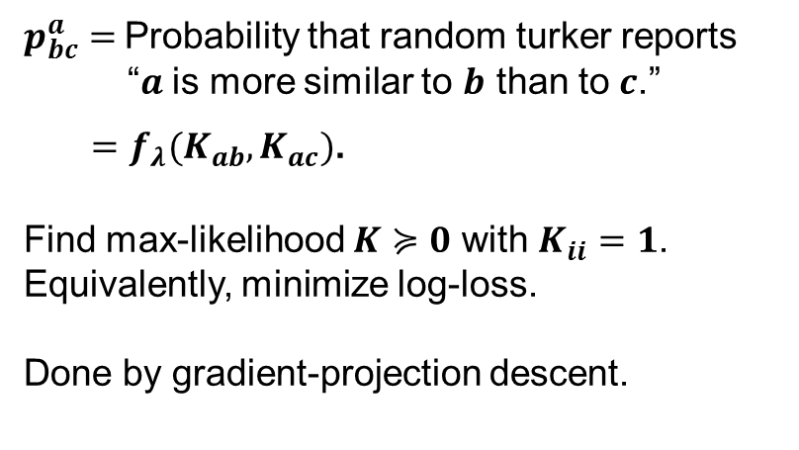


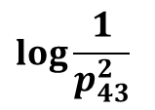
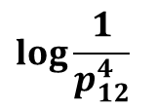


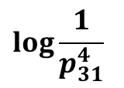

Fit $K$ to data
$$K_{12}$$
$$K_{13}$$
$$K_{14}$$
$$K_{23}$$
$$K_{24}$$
$$\log{\frac{1}{p_{31}^{4}}}$$
$$K_{34}$$
$$+$$
$p_{bc}^{a}=$Probability that random turker reports
“$a$ is more similar to $b$ than to $c$.”
$=f_{λ}(K_{ab},K_{ac})$.
Find max-likelihood $K≽0$ with $K_{ii}=1$.
Equivalently, minimize log-loss.
Done by gradient-projection descent.
$$\log{\frac{1}{p_{43}^{2}}}$$
$$+$$
$$\log{\frac{1}{p_{12}^{4}}}$$

Slide 12
Adaptive ALGORITHM
Turk random triples
Fit $K$ to all data so far
Fit 𝑲 to all data so far
Turk “most informative triples”
Maximum likelihood fit
to logistic or relative model
using gradient descent
We use probabilistic model +
information gain to decide how informative a triple is.

Slide 13
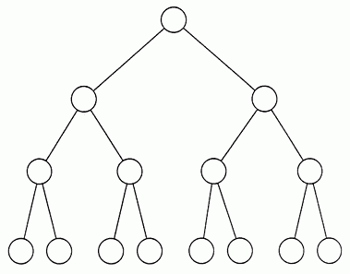

Lure of Adaptivity
Toy example: complete binary trees with $n$leaves, depth $O(log n)$
Avg. cost is $Θ\left(n\right) \text{from} \text{random} \text{queries}$.
Avg. cost is $Θ\left(log n\right)$ from adaptive queries.
Tie store
Scarves
Tie clips
Bow ties
Neck ties

Slide 14
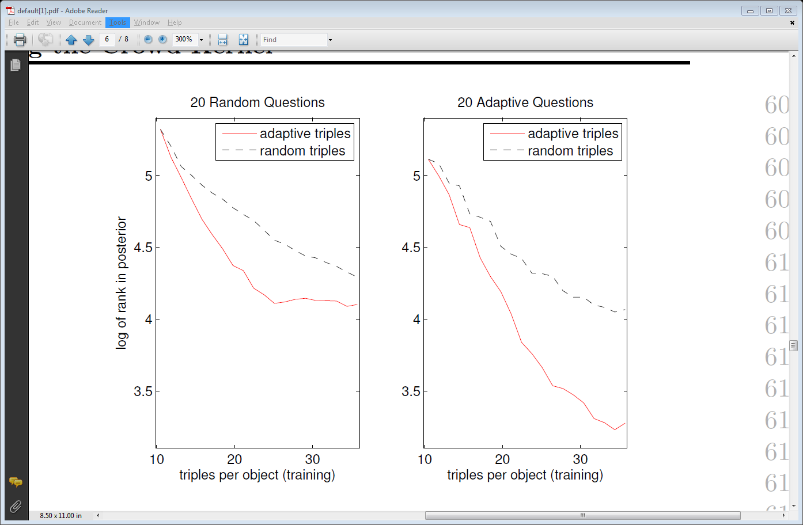
Performance Evaluation
20 Questions metric
Random object is chosen secretly
System asks 20 questions and then ranks objects in terms of likelihood
Dataset: 75 ties+75 tiles+75 flags

Slide 15
Labeling images with a computer game
Paper 2

Slide 16
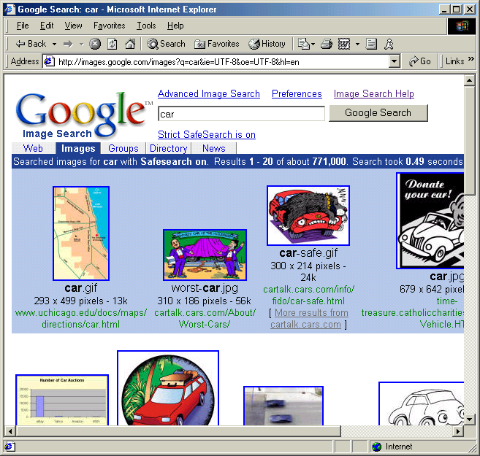
IMAGE SEARCH ON THE WEB
USES FILENAMES AND HTML TEXT

Slide 17
THE ESP GAME
TWO-PLAYER ONLINE GAME
PARTNERS DON’T KNOW EACH OTHER AND CAN’T COMMUNICATE
OBJECT OF THE GAME:
TYPE THE SAME WORD
THE ONLY THING IN COMMON IS AN IMAGE

Slide 18
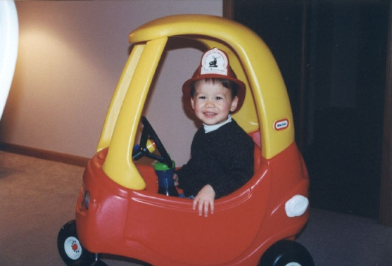
THE ESP GAME
PLAYER 1
PLAYER 2
GUESSING: CAR
GUESSING: BOY
GUESSING: HAT
GUESSING: CAR
GUESSING: KID
SUCCESS!
YOU AGREE ON CAR
SUCCESS!
YOU AGREE ON CAR

Slide 19
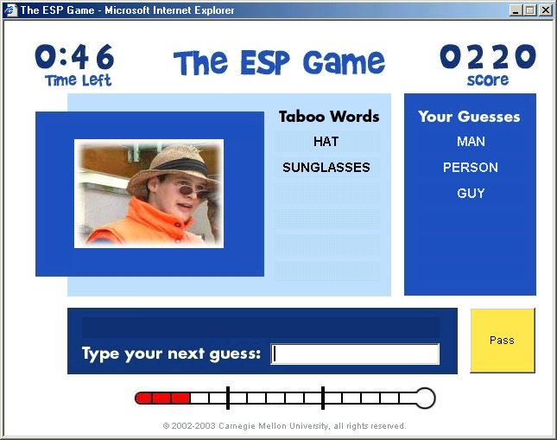
© 2004 Carnegie Mellon University, all rights reserved. Patent Pending.

Slide 20
WHAT ABOUT CHEATING?
IF A PAIR PLAYS TOO FAST, WE DON’T RECORD THE WORDS THEY AGREE ON

Slide 21
WHAT ABOUT CHEATING?
WE GIVE PLAYERS TEST IMAGES FOR WHICH WE KNOW ALL THE COMMON LABELS:
WE ONLY STORE A PLAYER’S GUESSES IF THEY SUCCESSFULLY LABEL THE TEST IMAGES

Slide 22
THE ESP GAME IS FUN
3.2 MILLION LABELS WITH 22,000 PLAYERS
MANY PEOPLE PLAY OVER 20 HOURS A WEEK

Slide 23
LABELING THE ENTIRE WEB
5000 PEOPLE PLAYING SIMULTANEOUSLY CAN LABEL ALL IMAGES ON GOOGLE IN 30 DAYS!
INDIVIDUAL GAMES IN YAHOO! AND MSN AVERAGE OVER 10,000 PLAYERS AT A TIME

Slide 24
A FEW MILLION LABELS
CAN BE USED TO IMPROVE ACCESSIBILITY FOR VISUALLY IMPAIRED
CAN BE USED TO IMPROVE COMPUTER VISION
CAN IMPROVE IMAGE SEARCH

Slide 25
Crowdclustering
Paper:3

Slide 26
What did they do?
Use crowdsourcing to discover categories

Slide 27
How? Approach
Each worker given M images to cluster.
Images are represented in d-dimensional euclidean space(hidden variables)
Atomic clusters: Dirichlet process mixture model
Worker: pairwise binary classifier with a bias(hidden variables)
A worker’s tendency to label pair of images is modelled as a pairwise logistic regression

Slide 28
How? Approach
The number of atomic cluster centres and their means and covariances need to be evaluated.

Slide 29
eXPERIMENTS

Slide 30

Color?

Slide 31

Color?

Slide 32

Color?

Slide 33

Color?

Slide 34
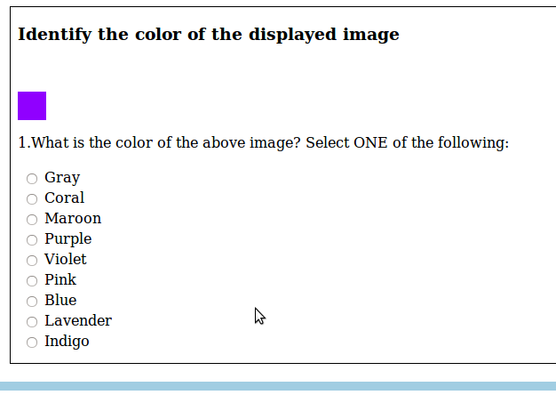
Crowdsourcing on Mechanical Turk

Slide 35
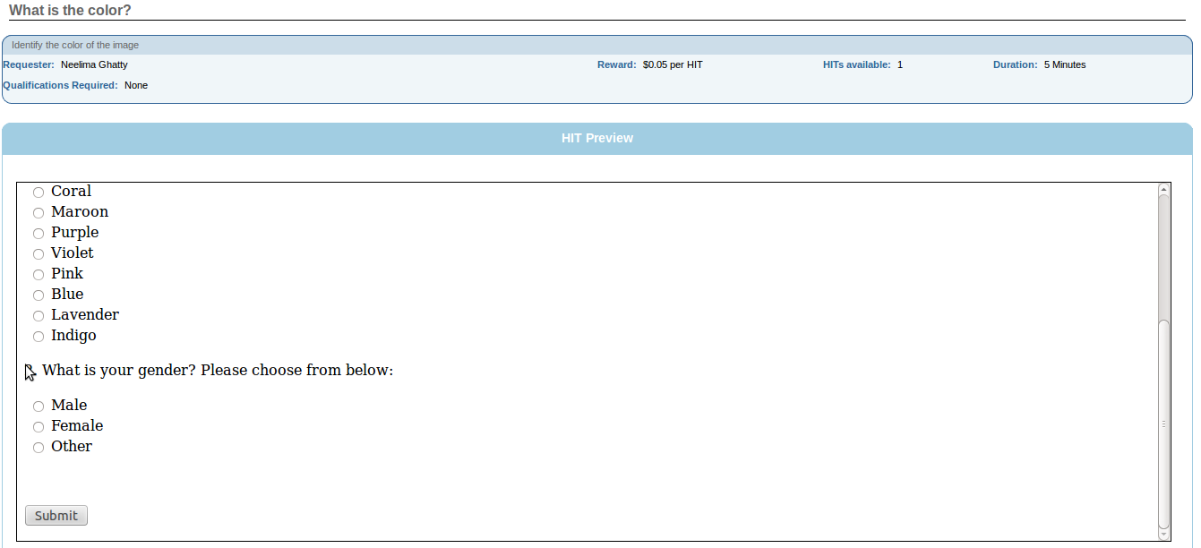
Crowdsourcing on Mechanical Truk

Slide 36
Results
Black
Red

Slide 37
Results
Lavender(male)

Slide 38
Results
Purple(female)

Slide 39
Results
Pink(female)

Slide 40
Results
Violet(female)

Slide 41
Acknowledgements
Dr. Parikh
Pavan Ghatty

